Slide 1
Pair Trade: Long BYD vs. Short Tesla
Team: AlphaStock

Slide 2
Introduction
01
Table of Contents
Industry and Company Overview
02
Valuation Comparison
03
Fundamental Catalysts & Risks
04
Technical Analysis
05
Risk Factors & Mitigation
06

Slide 3
Introduction
01
/

Slide 4
Title Slide
Title
Subtitle
Pair Trade Strategy: Long BYD vs. Short Tesla
Capitalizing on EV Industry Divergence & Valuation Gaps. This presentation proposes a pair trade strategy, leveraging the contrasting valuations and growth dynamics of BYD and Tesla in the evolving EV landscape.

Slide 5
Executive Summary
Thesis
Objective
Key Metrics
Long BYD: Undervalued leader in China’s ecosystem. BYD demonstrates substantial growth potential driven by its dominant position in the Chinese market. Short Tesla: Overvalued global incumbent facing margin pressures. Tesla's high valuation is unsustainable due to increasing competition and normalizing demand, leading to potential correction.
Exploit valuation discrepancies and regional growth asymmetry. Investment strategy aims to profit from the valuation gap between BYD, the Chinese EV leader, and Tesla, the global EV market giant.
Valuation multiples, growth rates, and margin trends. Monitoring these key metrics, including P/E ratios, EV/EBITDA, revenue growth, and net margins, is crucial for assessing the pair trade validity.

Slide 6
Industry and Company Overview
02
/

Slide 7
Global EV Market Trends
EV Market Domination
Regulatory Tailwinds
China dominates 60% of global EV sales; BYD leads. China's EV market leadership, propelled by BYD's dominance, provides a strong foundation for BYD's growth and contrasts with Tesla's challenges in saturated markets.
China’s subsidies, tax breaks, and infrastructure investments. Government incentives and investment are major drivers of BYD's success.

Slide 8
Company Overview - BYD
Growth Drivers
2023 sales: 3M+ EVs (+70% YoY); Export expansion. BYD's recent sales surge and expansion into new markets demonstrate its growing global presence and ability to capture market share.
Business Model
Financials
Vertically integrated (batteries, EVs, semiconductors). Vertical integration gives BYD a cost advantage.
2023E Revenue: $80B (+50% YoY); Net Margin: 5.2%. The company is seeing improvements in efficiencies.

Slide 9
Company Overview - Tesla
Business Model
Premium EVs, energy storage, software integration. Tesla's focus on high-end market segments, energy solutions, and software creates revenue streams but is increasingly challenged by competition.
Growth Challenges
2023 deliveries: 1.8M (+35% YoY), below targets. Price cuts erode margins (2023E gross margin: 18%). This shows the need to stay competitive by Tesla.
Financials
2023E Revenue: $110B (+25% YoY); Net Margin: 10%. Tesla is facing some struggles.

Slide 10
Valuation Comparison
03
/

Slide 11
Valuation Metrics
P/E Ratio
BYD (1211.HK): 25x vs. Tesla (TSLA.US): 60x. This shows that Tesla is overpriced.
EV/EBITDA
BYD (1211.HK): 18x vs. Tesla (TSLA.US): 40x. Tesla again looks to be overpriced
PEG Ratio
BYD: 0.8 vs. Tesla: 2.5. This shows that BYD has potential for growth.

Slide 12
Conclusion
Tesla's Premium
Visual Aid
Tesla trades at a significant premium despite slowing growth. This is not a good thing.
Valuation Multiples Heatmap, a visual reprentation of this data.

Slide 13
Fundamental Catalysts & Risks
04
/

Slide 14
BYD Catalysts
Battery Cost Leadership
Expansion in Europe
Policy Support
BYD's LFP technology lowers battery costs. LFP batteries provide a cost-effective competitive advantage for BYD.
BYD is expanding into Europe and is targeting 10% market share by 2025. This expansion diversifies revenue streams and reduces reliance on the Chinese market.
China’s dual-carbon goals. Government initiatives are driving BYD's growth.

Slide 15
Tesla Risks
Rising Competition
BYD, NIO, and legacy automakers are all becoming challengers. Increased competition in the EV sector is putting pressure on Tesla.
Margin Compression
Price cuts are eroding Tesla's margins. Price reductions to maintain market share are negatively affecting profitability.
Project Delays
Cybertruck delays and robotaxi skepticism impact growth. Uncertainty surrounding product launches and technological advancements is reducing investor confidence in Tesla.

Slide 16
Technical Analysis
05
/

Slide 17
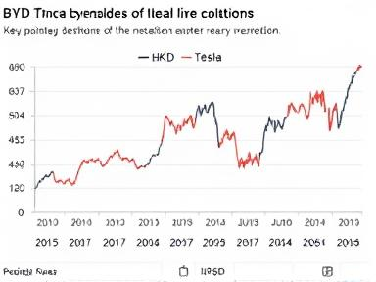
Price Ratio Chart
Historical Spread
BYD (HKD) vs. Tesla (USD) shares. This would reveal mean reversion opportunity.

Slide 18
Supporting Charts
RSI Momentum
BYD’s rising RSI momentum vs. Tesla’s bearish MACD divergence. Tesla's recent trends suggest potential downward momentum.

Slide 19
Risk Factors & Mitigation
06
/

Slide 20

Geopolitical Tensions
US-China Trade Barriers
Heightened trade tensions increase uncertainty. Monitor policy shifts.

Slide 21
Lithium Price Volatility
Lithium Price Fluctuations
Lithium price volatility impacts battery production costs. Hedge with commodity futures.

Slide 22
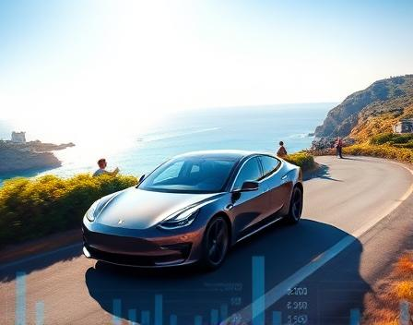
Brand Loyalty
Tesla Brand Power
Tesla’s brand loyalty offsetting bearish thesis. Mitigate with strategic monitoring of market sentiment.

Slide 23
Alternative Pairings & Conclusion
07
/

Slide 24
Alternative Pairings
Long BYD vs. Short Rivian (RIVN.US)
Long BYD vs. Short NIO (NIO.US)
Rivian has cash burn and production delays.
NIO has premium valuation compared to BYD’s profitability.

Slide 25
Conclusion and Recommendations
Trade Rationale
Target Spread
Monitoring Metrics
BYD’s valuation discount and Tesla’s overextension create a spread trade. The pair trade is compelling due to BYD's undervaluation and Tesla's unsustainable valuation.
20% convergence in P/E ratios over 12 months is ideal. This potential convergence generates substantial returns
Monthly EV delivery data, policy updates, and margin trends. Adapt to market dynamics.

Slide 26
Thank you
Team: AlphaStock

